Slide 1



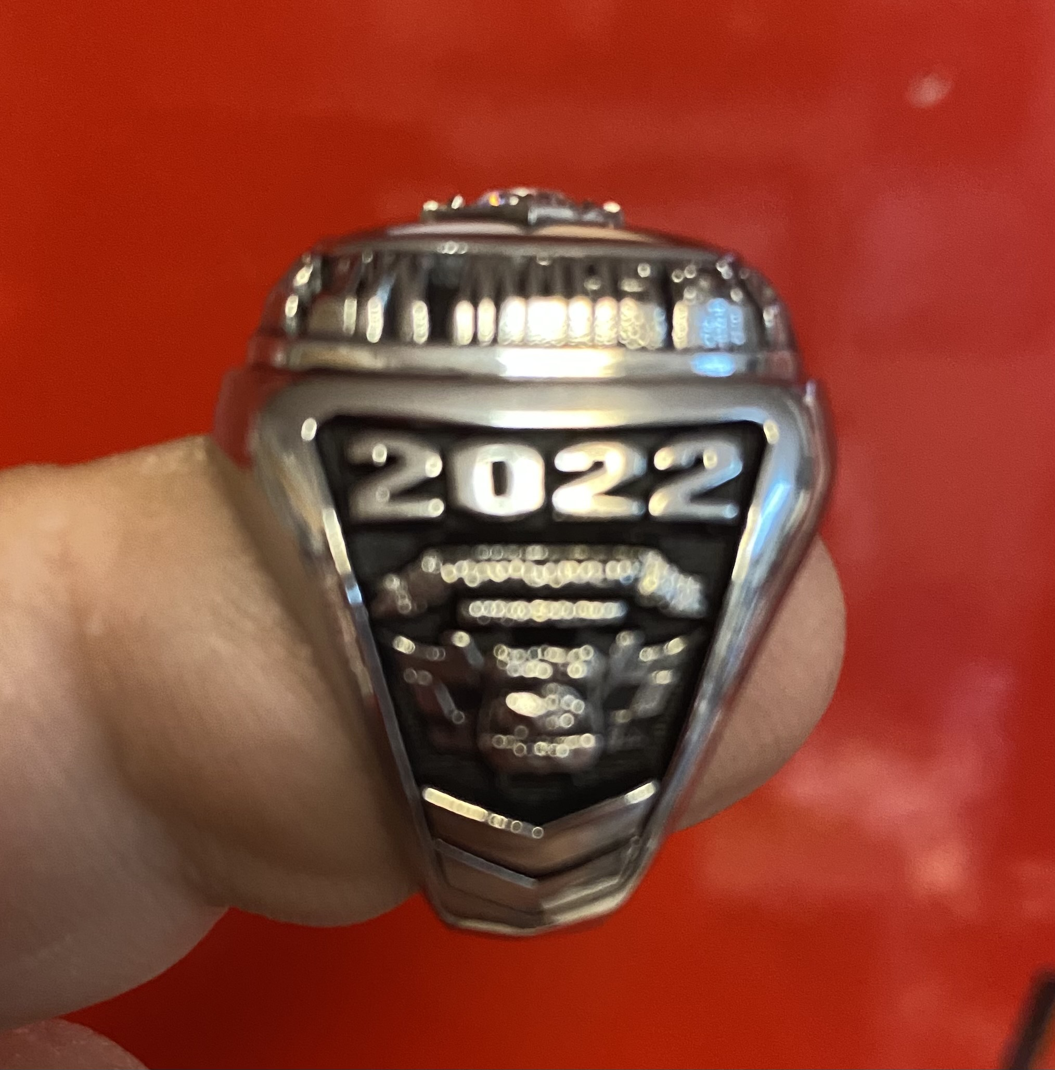
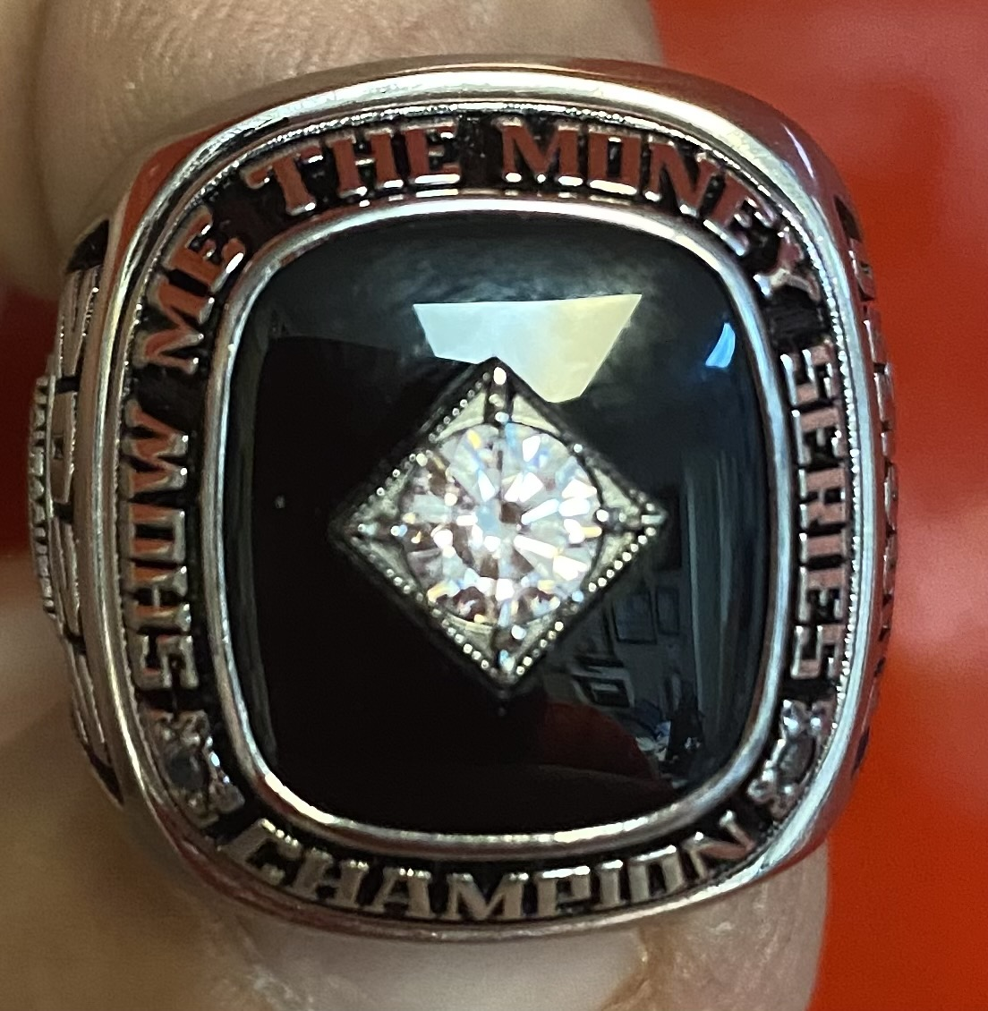
2023
Pro Late
Model Series
March 4, 2023 ALABAMA 200 “Hunt for the BEAR” 10K to win Plus Modifieds of Mayhem Tour & Shelby Concrete Street Stocks
April 29, 2023 “Spring Explosion 100”
May 27, 2023 “Disturbing the PEACE 100”
June 17, 2023 “Bring Dad to the Races 100”
August 5, 2023 “Saturday of SPEED 125”
September 30, 2023 “FALL BRAWL 100”

